Slide 1

COUNTRIES DATA
Objective: To categorise countries using socio-economic and health factors that determine the overall development of the country and identify the highest priority countries that need urgent aid.

Slide 2
child mortality | Death of children under 5 years of age per 1000 live births
exports | Exports of goods and services per capita. Given as percentage of the GDP per capita
health | Total health spending per capita. Given as %age of GDP per capita
imports | Imports of goods and services per capita. Given as %age of the GDP per capita
income | Net income per person
inflation | The measurement of the annual growth rate of the Total GDP
life expectancy | The average number of years a newborn child would live if the current mortality patterns are to remain the same
total fertility | The number of children that would be born to each woman if the current age-fertility rates remain the same
gdpp | The GDP per capita. Calculated as the Total GDP divided by the total population

Slide 3
Initial notes
There are no missing values in our data set, however not every UN recognised country is represented, this could be due to size, lack of data, or political instability.
Gross Domestic Product (GDP) is the total value of all goods and services produced in a country over a specific time period, and it is one of the ways to measure a country’s economic health and development. Per capita means per person so it is an averaege.

Slide 4
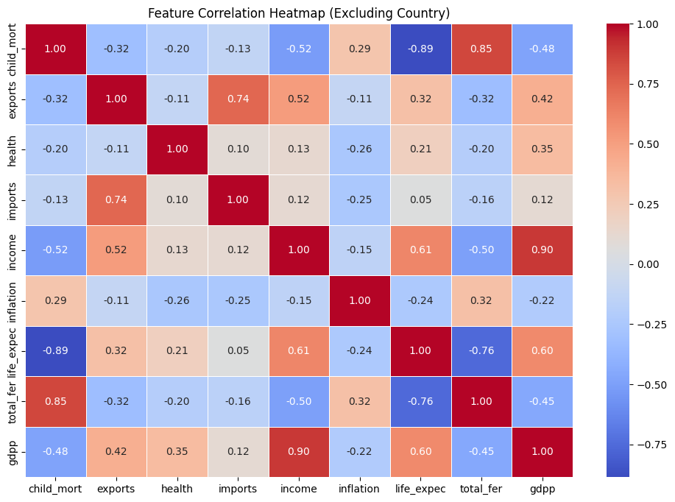
This correlation matrix shows the relationship between each variable.
As we might have expected, income and GDP per capita show a strong positive correlation.
Child mortality and Life expectancy show a strong negative correlation.

Slide 5
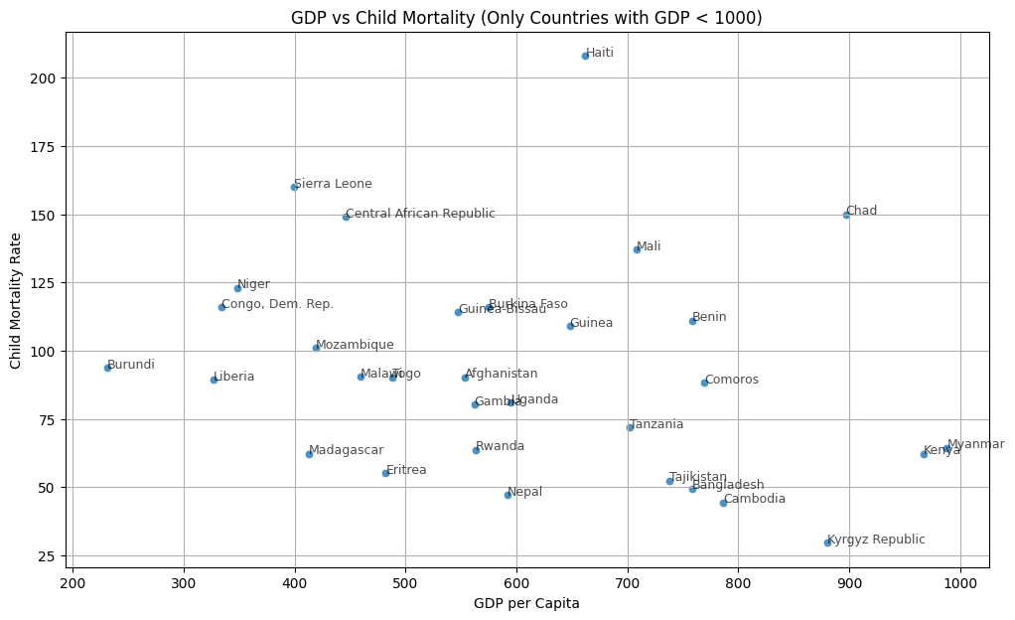

Slide 6
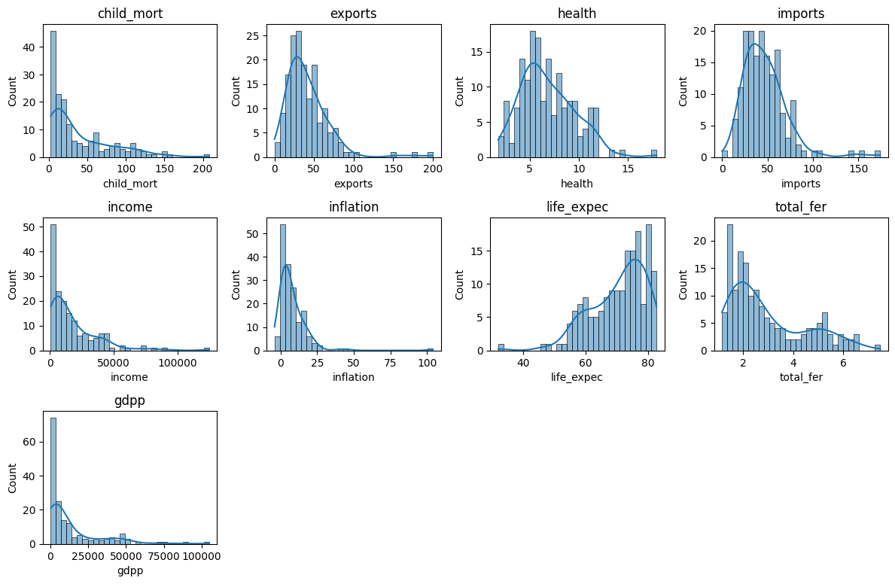
These are the histograms showing the distribution of each variable. We can see that most them exhibit skewed data rather than normally distributed data. Income and GDP per capita particularly show a large amount of right-skew and outliers from the economically powerful nations.

Slide 7
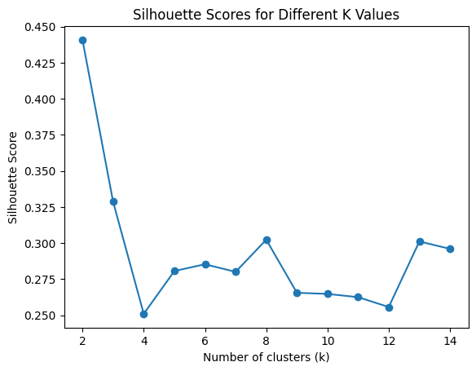
Preparing the data
After applying a Robust Scaler we can now perform K means clustering. This scaler was chosen over the Standard and MinMaxScaler as the data distributions are mostly skewed.
PCA has been applied, using 5 components whilst keeping 95% of the original variance.
K = 8

Slide 8
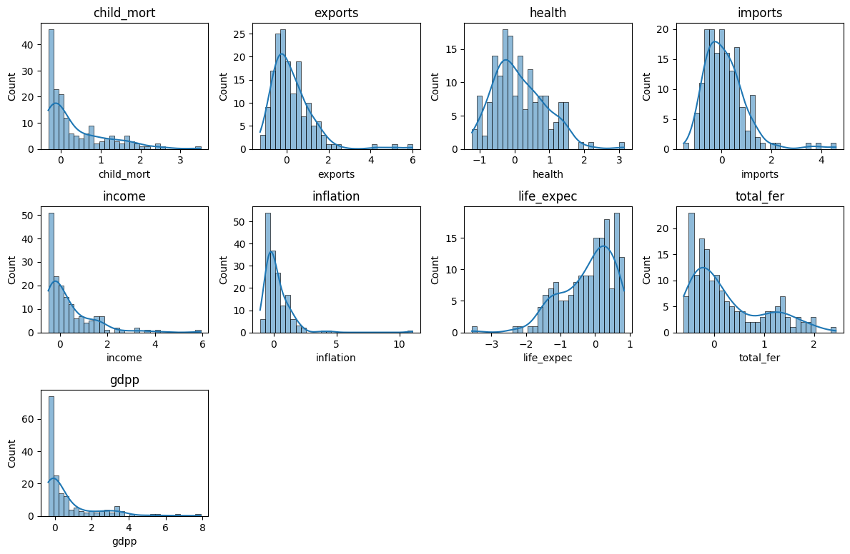
The same histograms after applying a Robust Scaler. The shapes have remained the same but the units are now more manageable and suitable for clustering analysis. Robust scaler was chosen as the histograms show skewness and not normally distributed.

Slide 9
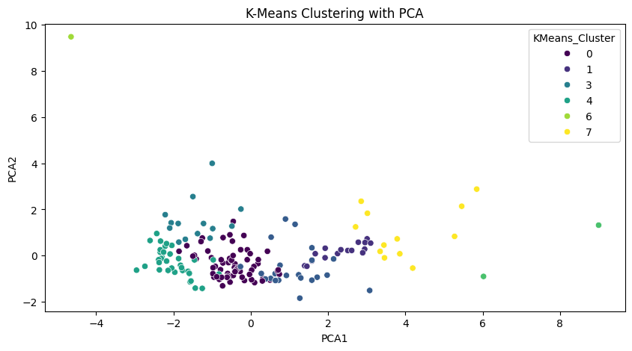
The model
Afghanistan, Bangladesh, Benin, Burkina Faso, Burundi, Cameroon, Central African Republic, Chad, Comoros, Congo, Dem. Rep., Cote d'Ivoire, Eritrea, Gambia, Ghana, Guinea, Guinea-Bissau, Haiti, India, Kenya, Lao, Liberia, Madagascar, Malawi, Mali, Mozambique, Myanmar, Nepal, Niger, Pakistan, Rwanda, Senegal, Sierra Leone, Tajikistan, Tanzania, Togo, Uganda, Zambia
37 countries.

Slide 10
Measure the accuracy
Even with 8 clusters, these 37 countries were all in one cluster. All of these countries have a very low GDPP and a high child mortality rate, which is what we were looking for.
Silhouette Score: 0.3
Hierarchical Agglomerative Clustering on the same data gave a silhouette score of 0.24, so did not separate the data as effectively as K means clustering.

Slide 11
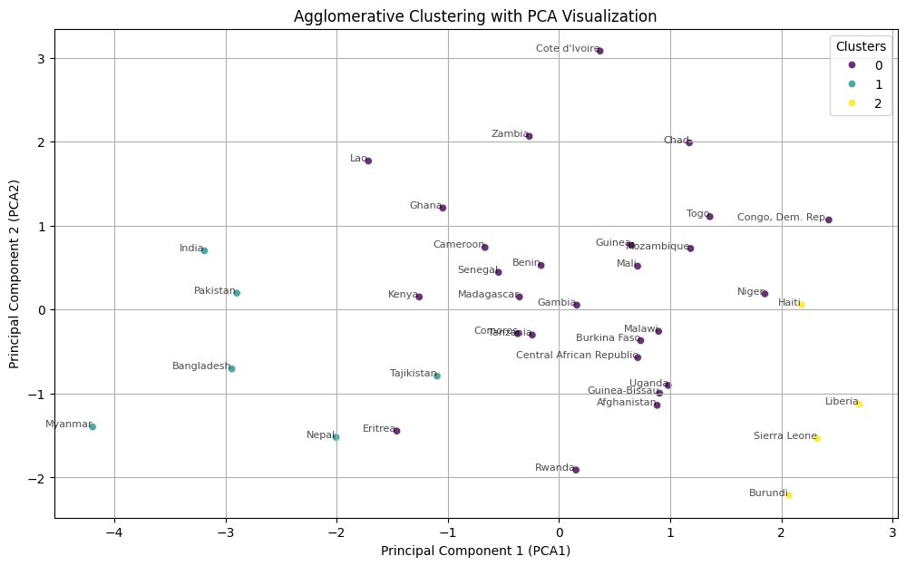
Filtering the 37 high-risk countries further…
K means silhouette score: 0.16
Agglomerative score: 0.3, split the data into 3 clusters more effectively.
Burundi, Sierra Leone and Liberia are very close together.
Cluster 2 can be our top priority group.

Slide 12
Conclusion
Our 4 countries to prioritise are Burundi, Haiti, Liberia and Sierra Leone.
Burundi, Liberia and Sierra Leone are all very similar with a GDPP of under 400, much higher imports than exports and high health spending.
Haiti is slightly more well off than the others but has by far the highest child mortality rate and lowest life expectancy in the list which allowed it to just be part of cluster number 2.
Overall happy with how it turned out, we have the two highest child mortality rates and the two lowest GDPP represented…
Congo DR missed out due to their high number of exports. However, this is not reflected in their GDP per capita as they are third lowest. They also have an alarmingly high child mortality rate so probably should have made the final cluster.
Central African Republic missed out due to their relatively low health spending despite being identified early on as a possible high priority country.

